Slide 1
Problems, Problem Spaces and Search

Slide 2
Problem solving
We want:
To automatically solve a problem
We need:
A representation of the problem
Algorithms that use some strategy to solve the problem defined in that representation

Slide 3
To build a system to solve a problem
Define the problem precisely by including specification of initial situation, and final situation constituting the solution of the problem.
Analyze the problem to find a few important features for appropriateness of the solution technique.
Isolate and represent the knowledge that is necessary for solution.
Select the best problem solving technique.

Slide 4
Problem representation
General:
State space: a problem is divided into a set of resolution steps from the initial state to the goal state
Reduction to sub-problems: a problem is arranged into a hierarchy of sub-problems
Specific:
Game resolution
Constraints satisfaction

Slide 5
Important Terms
Search space → possible conditions and solutions.
Initial state → state where the searching process started.
Goal state → the ultimate aim of searching process.
Problem space → “what to solve”
Searching strategy →strategy for controlling the search.
Search tree → tree representation of search space, showing possible solutions from initial state.

Slide 6
States
A problem is defined by its elements and their relations.
In each instant of the resolution of a problem, those elements have specific descriptors (How to select them?) and relations.
A state is a representation of those elements in a given moment.
Two special states are defined:
Initial state (starting point)
Final state (goal state)

Slide 7
State Space
The state space of a problem includes :
An initial state,
One or more goal states.
Sequence of intermediate states through which the system makes transition while applying various rules.
State space may be a tree or a graph.

Slide 8
State modification: successor function
A successor function is needed to move between different states.
A successor function is a description of possible actions, a set of operators. It is a transformation function on a state representation, which convert it into another state.
The successor function defines a relation of accessibility among states.
Representation of the successor function:
Conditions of applicability
Transformation function

Slide 9
State space
The state space is the set of all states reachable from the initial state.
It forms a graph (or map) in which the nodes are states and the arcs between nodes are actions.
A path in the state space is a sequence of states connected by a sequence of actions.
The solution of the problem is part of the map formed by the state space.

Slide 10
Problem solution
A solution in the state space is a path from the initial state to a goal state or, sometimes, just a goal state.
Path/solution cost: function that assigns a numeric cost to each path, the cost of applying the operators to the states
Solution quality is measured by the path cost function, and an optimal solution has the lowest path cost among all solutions.
Solutions: any, an optimal one, all. Cost is important depending on the problem and the type of solution sought.

Slide 11
Problem description
Components:
State space (explicitly or implicitly defined)
Initial state
Goal state (or the conditions it has to fulfill)
Available actions (operators to change state)
Restrictions (e.g., cost)
Elements of the domain which are relevant to the problem (e.g., incomplete knowledge of the starting point)
Type of solution:
Sequence of operators or goal state
Any, an optimal one (cost definition needed), all

Slide 12
Example Problems
Toy Problems | Real-world Problems
Vacuum World | Route Finding
8 -Puzzle | Traveling Salesperson
8 -Queens | VLSI Layout
Crypt Arithmetic | Robot Navigation
Missionaries And Cannibals | Web Search

Slide 13
Production System
Production systems can be defined as a kind of cognitive architecture, in which knowledge is represented in the form of rules.
So, a system that uses this form of knowledge representation is called a production system.
To simply put, production systems consists of rules and factors. Knowledge is usually encoded in a declarative from which comprises of a set of rules of the form.

Slide 14
The rules in a production system are determined by LHS (left-hand side) and RHS (right-hand side) equations,
where LHS denotes the specific condition to be applied, and
RHS shows the output of the applied condition.

Slide 15
Components of a production system
A Global Database
Set of Production rules
A control System

Slide 16
The major components of Production System in Artificial Intelligence are:
Global Database: The global database is the central data structure used by the production system in Artificial Intelligence.
Set of Production Rules: The production rules operate on the global database. Each rule usually has a precondition that is either satisfied or not by the global database. If the precondition is satisfied, the rule is usually be applied. The application of the rule changes the database.
A Control System: The control system then chooses which applicable rule should be applied and ceases computation when a termination condition on the database is satisfied. If multiple rules are to fire at the same time, the control system resolves the conflicts.

Slide 17
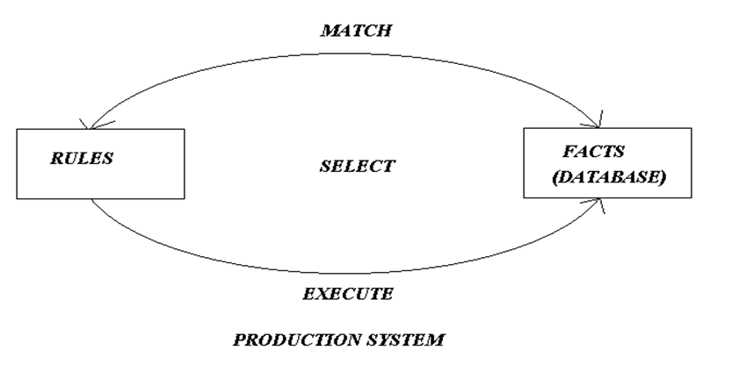

Slide 18
Advantages of Production system in artificial intelligence are:
Provides an excellent base for structuring AI Problems
Each rule can be added, removed or modified independently, which makes the system highly modular.
Helpful in designing real-time applications.
Provides opportunities for heuristic control of the search.
A good way to model the state-driven nature of intelligent machines.
More flexible than algorithmic control.
Language independent

Slide 19
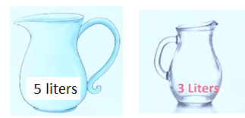
A Water Jug Problem:1
You are given two jugs, a 5-gallon one and a 3-gallon one, a pump which has unlimited water which you can use to fill the jug, and the ground on which water may be poured. Neither jug has any measuring markings on it.
Our task is to get 4 gallon of water in the 5 gallon jug

Slide 20
State Space Representation:
we will represent a state of the problem as a tuple (x, y)
where x represents the amount of water in the 5-gallon jug and
y represents the amount of water in the 3-gallon jug.
Note that 0 ≤ x ≤ 5, and 0 ≤ y ≤ 3.
Here ,
The initial state is (0, 0).
The goal state is (5, y) for any value of y

Slide 21
Production rules

Slide 22
To solve this water jug problem all we need is a control structure that can loop over certain applicable rules till the solution is achieved.
For the water jug problem there are several sequences of operators that solve the problem.

Slide 23
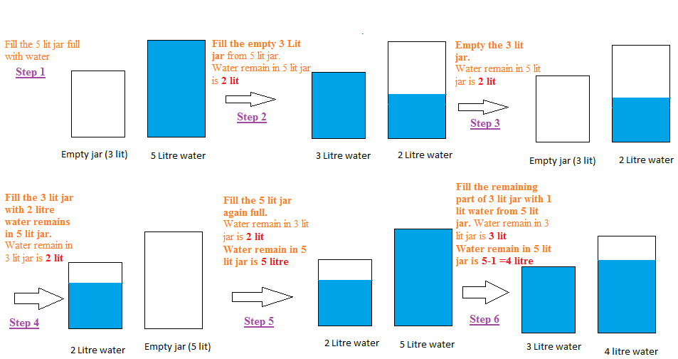
One of the possible solution :

Slide 24
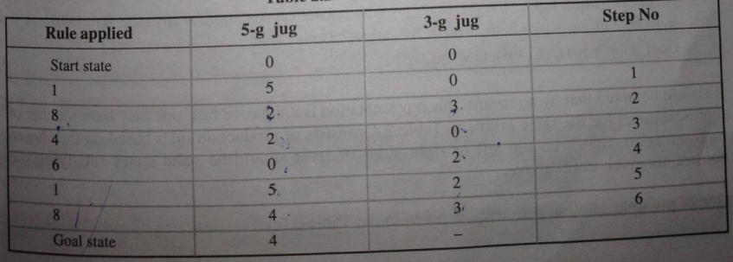

Slide 25
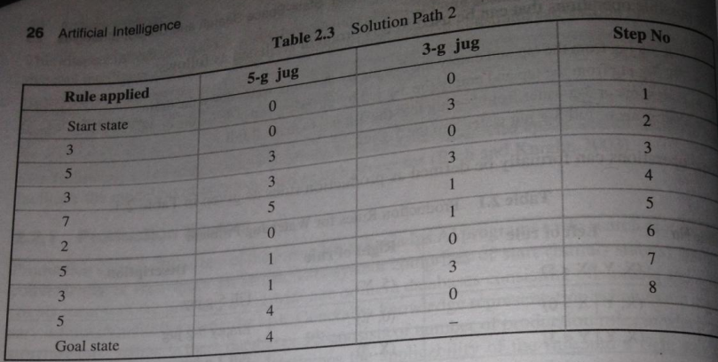
Another possible solution:…..

